Slide 1
PERFORMING ARTS
DANCE

Slide 2
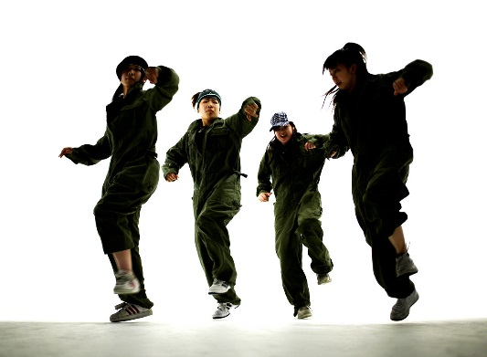
Lesson Objective
Participate in an effective warm up showing focus, energy and determination.
Continue to learn the street dance routine focusing on timing, pace and technique
Work on the feedback given to you last lesson to set targets.

Slide 3
Success Criteria
Level | Dance Strand
 | 1 Creating | 2 Performing | 3 Reflecting
Entry | I can remember a range of actions I can create phrases based on a stimulus or music | I can participate in a short group performance I show some consideration of spatial awareness in performance | I can recognise when my own work and the work of others’, could be improved
1 | I can perform simple dance phrase demonstrating choreographic skills | I can use appropriate characterisation in a performance | I can talk about why I made certain decisions in my choreography I can show a basic understanding of how a stimuli can be conveyed
2 | I can create a choreography using unison and cannon I can learn teacher led sequences and then use these to develop my own levels I can create a choreography using a range of stimuli I can take on feedback to improve my choreography such as using levels and/or contract work I can sustain a focus within a performance | I can learn a routine and take part in simple performances | I can give suggestions on how work could be improved I can talk about my work using some dance terminology I can identify strengths and weaknesses in my own and others work
3 | I can select and apply movement to match the given dance style I can work confidently in a group using a range of choreographic devices to explore different dance styles and ideas I can create and rehearse performance that make use of the range of techniques and dynamics to express my ideas I can give and accept suggestions to/from peers and teachers during the rehearsal process I can learn and create dances in a variety of styles | I experiment with different actions to create a performance I can create routines that are appropriate to the given style or stimuli I can experiment with different styles/actions and dynamics when developing a routine I improve and refine my performance through the rehearsal process I can choreograph a short performance for an audience I can perform a variety of different dance styles | I can reflect on and evaluate my own and other pupils’ work, suggesting improvements I can use key words when talking about dances that I have seen or participated in I can discuss the ways that ideas are communicated

Slide 4
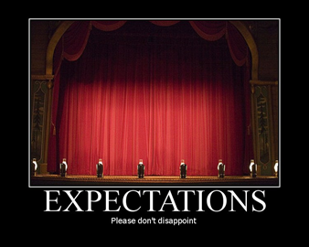

RECAP-EXPECTATIONS
BE RESPECTFUL OF OTHERS IN THE CLASS.
TRY YOUR HARDEST AT ALL TIMES.
LISTEN TO FEEDBACK AND USE THIS CONSTRUCTIVELY TO IMPROVE YOUR PERFORMANCE.
LISTEN TO THE TEACHER AT ALL TIMES.
BE ABLE TO WORK AS A GROUP AND INDEPENDENTLY.
BE CREATIVE.
USE THE STAGE EFFECTIVELY.
LISTEN TO YOUR PEERS IDEAS

Slide 5
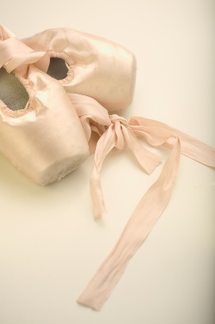
Key words
MUSICALITY
DYNAMICS
LEVELS
SPACING
POSTURE
MOVEMENT MEMORY

Slide 6

WHAT ARE THE COMPONENTS OF A WARM UP?
HOW MANY SECONDS DO YOU HOLD A STRETCH FOR?
WHY DO WE WARM UP?
WHAT ARE THE KEY COMPONENTS OF STREET DANCE?

Slide 7

SET YOURSELF 3 TARGETS TO HELP YOU IMPROVE YOUR STREET DANCE ROUTINE BASED ON THE FEEDBACK GIVEN TO YOU LAST WEEK .

Slide 8
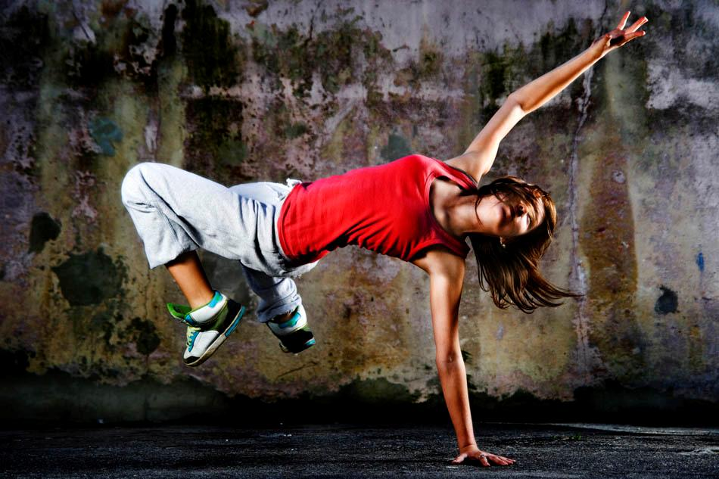
STREET DANCE
RECAP STREET DANCE ROUTINE
USE THE TARGETS WHICH YOU HAVE SET TO IMPROVE YOUR PERFORMANCE.
CREATE 2X8 COUNTS WHICH ADDS ONTO THE MOVEMENT YOU CREATED LAST WEEK.
REHEARSE THE WHOLE STREET DANCE ROUTINE THINKING ABOUT PERFORMANCE SKILLS READY FOR YOUR ASSESSMENT NEXT WEEK.

Slide 9

EXTENSION TASK PERFORMANCE!
In 2 groups you will now perform the routine to each other.
LEVEL CHECK!
DON’T worry if you go wrong- carry on!

Slide 10
PLENARY
What have you learnt today?
Have you achieved your targets?
Each corner of the room is a level. Go to the corner you think you are at and be ready to explain why and how you could improve.

